Slide 1
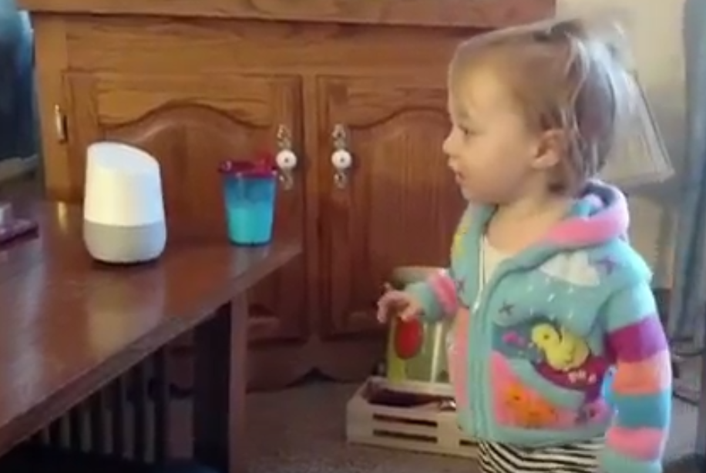
Natural Language Processing with Transformers L1 – NLP Intro
Jay Urbain, PhD
jay.urbain@gmail.com
https://www.linkedin.com/in/jayurbain/
https://github.com/jayurbain
March 2022

Slide 2
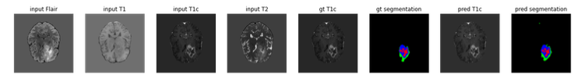
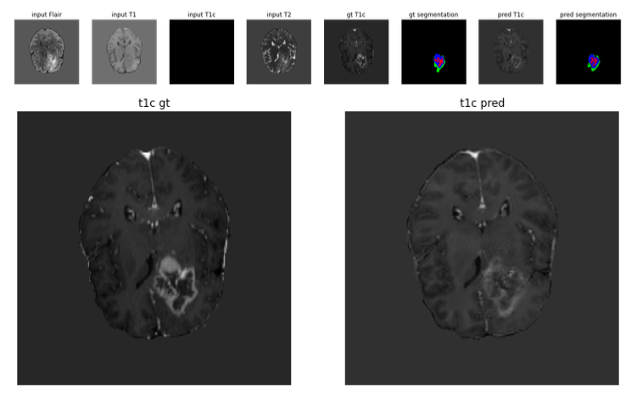

Slide 3
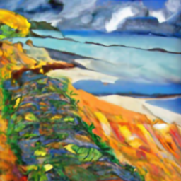
“Van Gogh painting of a beach”
Clip-guided diffusion model
Notes:
https://colab.research.google.com/github/openai/glide-text2im/blob/main/notebooks/clip_guided.ipynb#scrollTo=xM7b2E6s2Wxm

Slide 4


“monet painting of violet flowers in the mountains”
Clip-guided diffusion model
“monet painting of flowers by a river”
Clip-guided diffusion model
Notes:
https://colab.research.google.com/github/openai/glide-text2im/blob/main/notebooks/clip_guided.ipynb#scrollTo=xM7b2E6s2Wxm

Slide 5
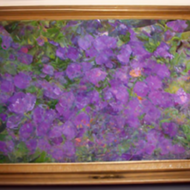
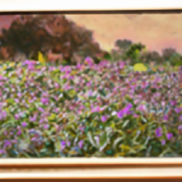
“monet painting of violet flowers ”
Clip-guided diffusion model
“monet painting of violet flowers in a field”
Clip-guided diffusion model
Notes:
https://colab.research.google.com/github/openai/glide-text2im/blob/main/notebooks/clip_guided.ipynb#scrollTo=xM7b2E6s2Wxm

Slide 6


picaso painting using van gogh colors
Clip-guided diffusion model
“picaso”
Clip-guided diffusion model
Notes:
https://colab.research.google.com/github/openai/glide-text2im/blob/main/notebooks/clip_guided.ipynb#scrollTo=xM7b2E6s2Wxm

Slide 7

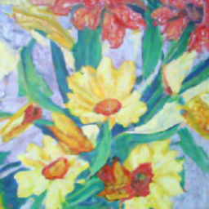
van gogh painting of flowers and mountains
Clip-guided diffusion model
“monet painting of water lilies”
Clip-guided diffusion model
Notes:
https://colab.research.google.com/github/openai/glide-text2im/blob/main/notebooks/clip_guided.ipynb#scrollTo=xM7b2E6s2Wxm

Slide 8


oil painting of violet flowers
Clip-guided diffusion model
“picasso painting of flowers using van gogh colors”
Clip-guided diffusion model
Notes:
https://colab.research.google.com/github/openai/glide-text2im/blob/main/notebooks/clip_guided.ipynb#scrollTo=xM7b2E6s2Wxm

Slide 9


Picasso painting of flowers
Clip-guided diffusion model
“monet painting of flowers”
Clip-guided diffusion model
Notes:
https://colab.research.google.com/github/openai/glide-text2im/blob/main/notebooks/clip_guided.ipynb#scrollTo=xM7b2E6s2Wxm

Slide 10
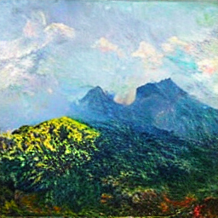
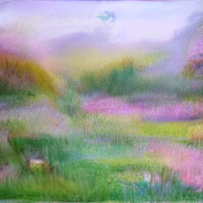
Mountain landscape in the style of monet
https://huggingface.co/spaces/huggan/wikiart-diffusion-mini
A peaceful meadow, pastel crayons
https://huggingface.co/spaces/huggan/wikiart-diffusion-mini
Notes:
https://colab.research.google.com/github/openai/glide-text2im/blob/main/notebooks/clip_guided.ipynb#scrollTo=xM7b2E6s2Wxm

Slide 11

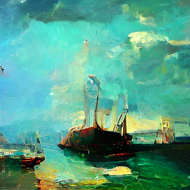
A painting of a vase of flowers
https://huggingface.co/spaces/huggan/wikiart-diffusion-mini
A peaceful meadow, pastel crayons
https://huggingface.co/spaces/huggan/wikiart-diffusion-mini
Notes:
https://colab.research.google.com/github/openai/glide-text2im/blob/main/notebooks/clip_guided.ipynb#scrollTo=xM7b2E6s2Wxm

Slide 12
What is Natural Language Processing?
Why is NLP hard?
Core NLP Tasks
Applications
Deep Learning for NLP
Future Directions
TOPICS
I am convinced that the crux of the problem of learning is recognizing relationships and being able to use them.
-- Christopher Strachey in a letter to Alan Turing, 1954

Slide 13
Automatic Writing
NLP TASKS
General Q&A
Intent Detection
Summary Generation
Common Sense Reasoning
Natural Language Processing
Word Sense
Auto Completion
Automatic Dialogue Generation
Translation
Sentiment Analysis
Code Generation
And many more….

Slide 14
WHAT IS NATURAL LANGUAGE PROCESSING (NLP)?

Slide 15
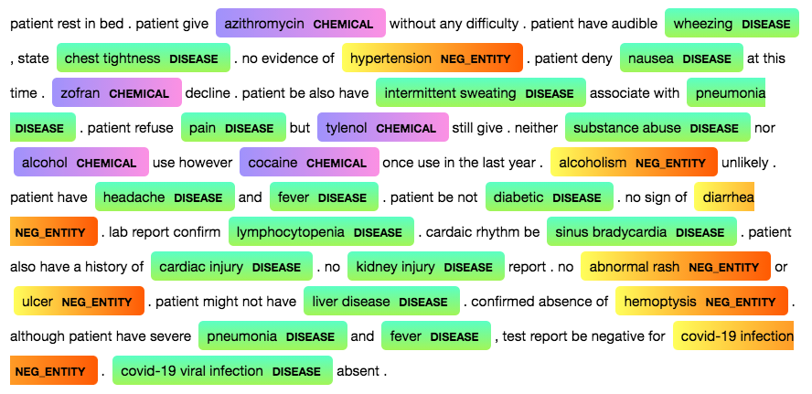

NATURAL LANGUAGE PROCESSING (NLP)
Goal: for computers to process and “understand” natural language.
Add structure and meaning to unstructured text in order to make text “computational.” Allows us to perform useful tasks:
Q/A, information extraction, language translation, summarization, search.
http://localhost:8888/notebooks/NLP_KG_2021/Scispacy_NE.ipynb
Notes:
Natural language processing is a field at the intersection of:
Computer Science
Artificial Intelligence
Linguistics

Slide 16


Scientific Goals: Natural language Processing
Human language is constructed to convey meaning.
Provides insight into human cognition.
Highly efficient, dynamic signaling system. Adapts to context.
Mostly a discrete categorical system (concept, attributes, relations):
rocket = violin =
Solve a major problem in AI
Understanding and representing the full meaning of language is unsolved.

Slide 17
WHY IS NLP HARD? … and Deep Learning can help

Slide 18


Language: the ultimate UI
Where is A Bug’s Life playing in Milwaukee?
A Bug’s Life is playing at the Downer Theater.
When is it playing there?
It’s playing at 2pm, 5pm, and 8pm.
OK. I’d like 1 adult and 2 children for the first show.
How much would that cost?
But we need domain knowledge, discourse knowledge, world knowledge
Notes:
After all, language is really the ultimate user interface – well, maybe not for all applications, maybe not for Photoshop.
But wouldn’t it be incredibly useful if you could have an interaction like this?
But this is well beyond what we can do today. Take a moment to consider what makes this hard.
Let me focus just on the problem of reference resolution – figuring out what various expressions refer to.
We need to recognize that “A Bug’s Life” refers to a movie, and “Milwaukee” refers to a town.
We need to figure out that “it” refers to “A Bug’s Life”, “there” refers to “the Downer Theater”, and “that” refers to the tickets.
And we need to understand that people don’t generally buy adults and children, and therefore that the user is referring to buying adult and child tickets.
We also need to figure out that “the first show” refers to 2pm, because 2pm is earlier than 5pm and 8pm.
And that’s just for reference resolution. So this is really quite challenging. [>]
Domain knowledge – Bug’s life is a movie, Milwaukee is a city
Discourse – the meaning of language within a context, e.g., knowing how a conversation fits together
World knowledge – the knowledge that we already have and can draw on in a conversation

Slide 19

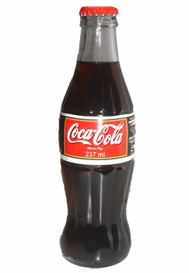


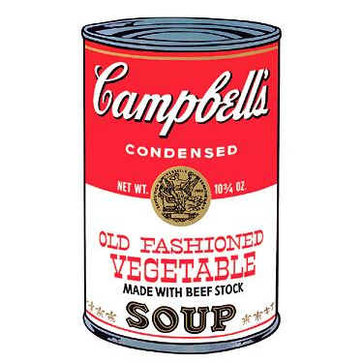
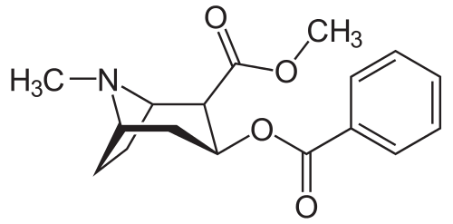
Meanings and expressions
Big obstacle: relation between meanings and expressions is not one-to-one
soda
Biebster
soft drink
pop
beverage
Coke
Many expressions, many meanings …
Notes:
One big obstacle is that the relation between meanings and expressions is not one-to-one. Far from it.
First, one meaning can be expressed in many different ways – so this thing can be described as “soda”, or a “soft drink”, or “pop”.
And conversely, one expression can have many different meanings – so “pop” can refer to the Biebster, or your Dad, or even Pop Art. [>]

Slide 20
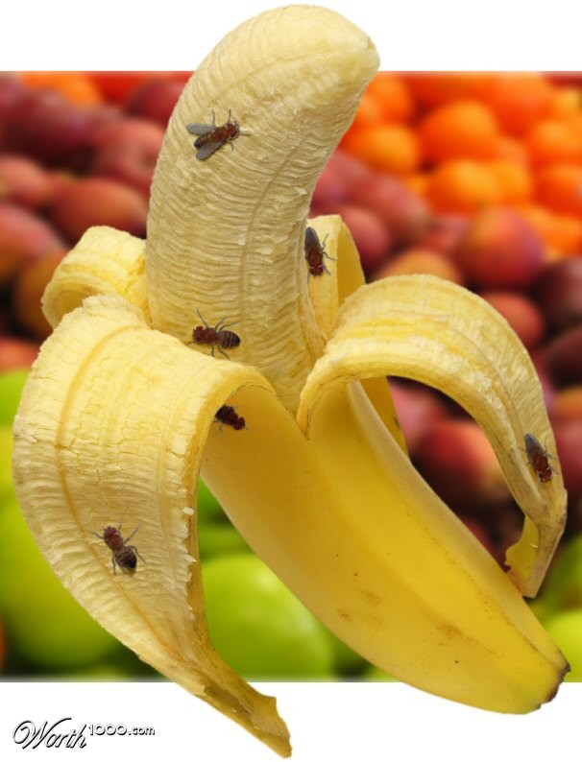
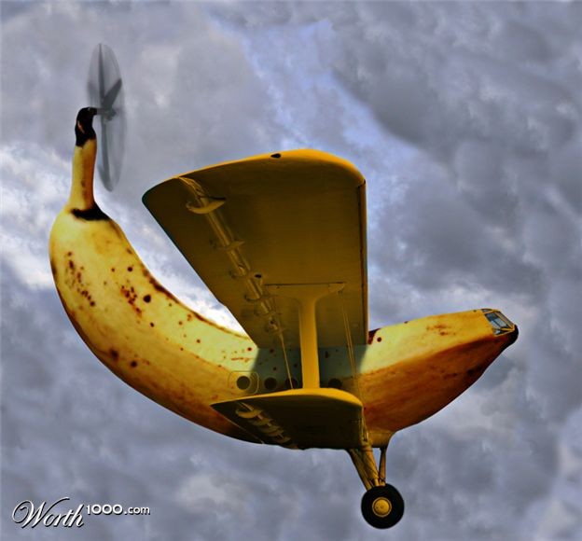
Syntactic & semantic ambiguity
syntactic ambiguity
S
S
VP
VP
semantic ambiguity
PP
NP NP
NP NP
Fruit flies like a banana
Fruit flies like a banana
[“like” is a remarkable word: it can be used as a noun, verb, adverb,
adjective, preposition, particle, conjunction, or interjection.]
photos from worth1000.com
Notes:
So we have two possible readings, represented here pictorially. And we have two different kinds of ambiguity.
First, there is semantic ambiguity.
“Flies” could be a noun, meaning insects, or it could be a verb, meaning travel by air.
And “like” could be a verb, meaning love, or it could be a preposition, meaning similar to.
[“like” is a remarkable word: it can be used as a noun, verb, adverb, adjective, preposition, particle, conjunction, or interjection.]
And then we also have a syntactic ambiguity.
It could be that “fruit flies” is the subject, and “like a banana” is the predicate.
Or it could be that “fruit” is the subject, and “flies like a banana” is the predicate.
These kind of ambiguities show up all over the place, and as humans, we’re so good at resolving them that usually we don’t even notice them consciously.
But sometimes, unintentional ambiguities produce a quite comic effect. [>]

Slide 21
Capturing context and semantics
General concepts –
Protein, gene, expression, or disease, take on a more specific meaning when coupled with contextual information about a topic.
protein + chronic wasting disease => prion protein.
progression + neoplasm => tumor progression.

Slide 22
We need models that can capture context and semantics
Ambiguous terms –
TREC query: How to "open up cell through "electroporation," only one distinct concept: electroporation, as the acronym EPT, was identified.
Which passage is relevant?
Passage 1: …malignant potential among endocrine pancreatic tumors (EPTs) varies greatly and can frequently not be predicted using histopathological parameters…
Passage 2: … EPT which uses pulsed electric fields in combination with a chemotherapeutic agent is being developed to treat human pancreatic tumors…
Notes:
Identifying concepts solely by term matching fails to disambiguate polysemous terms.
Electroporation is a physical transfection method that uses an electrical pulse to create temporary pores in cell membranes through which substances like nucleic acids can pass into cells.

Slide 23
CORE NLP TASKS

Slide 24
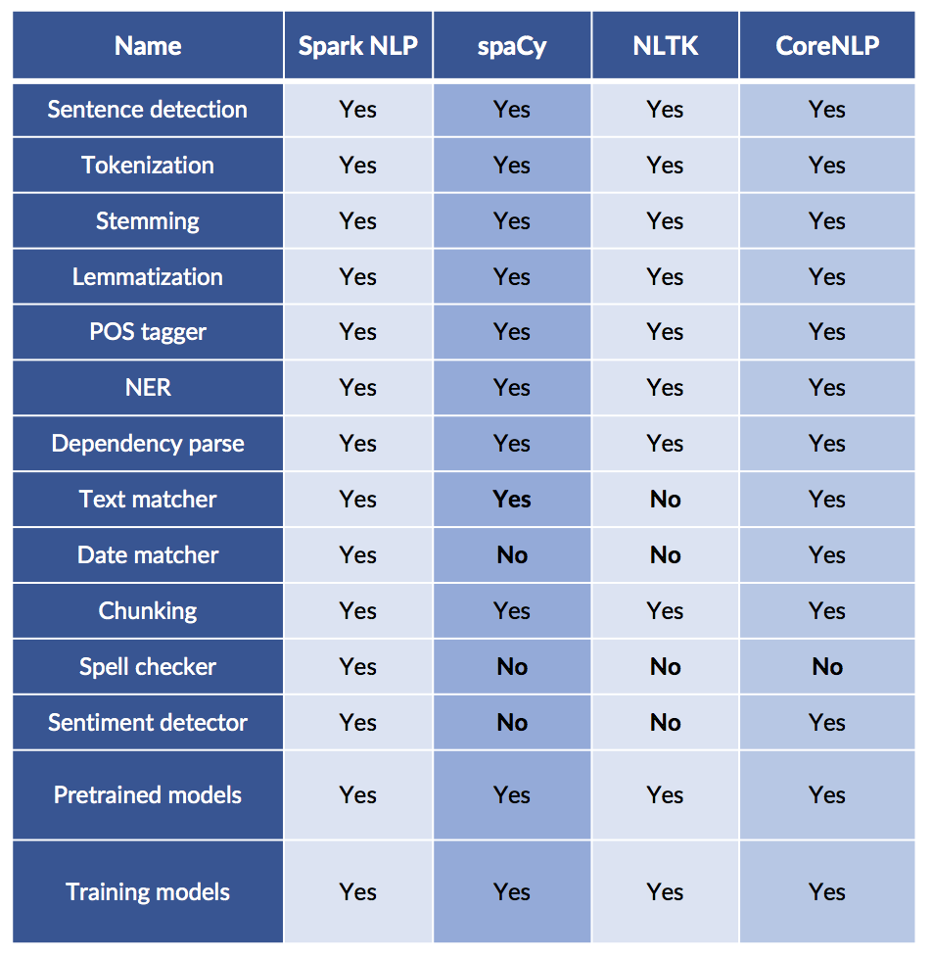
Core Open-source NLP Libraries

Slide 25
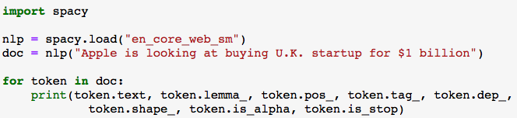
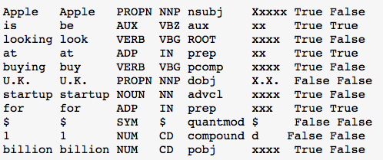
Core NLP Features
Lemma
POS
Tag
Dep
Shape
alpha
stop
Text: The original word text.
Lemma: The base form of the word.
POS: The simple UPOS part-of-speech tag.
Tag: The detailed part-of-speech tag.
Dep: Syntactic dependency, relation
between tokens.
Shape: Capitalization, punctuation, digits.
is alpha: Is the token an alpha character?
is stop: Is the token part of a stop list?

Slide 26
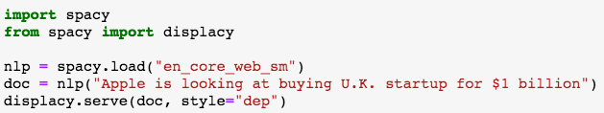
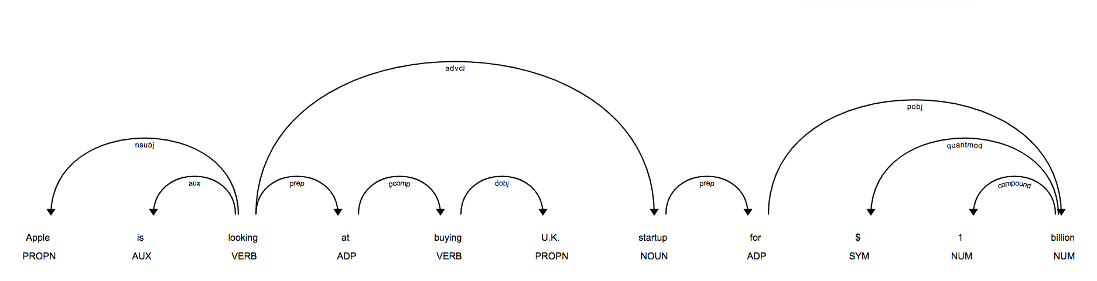
Syntactic dependency, relation between tokens
Helpful for information extraction
Identify (subject, predicate, object)
Entity and it’s attributes
Sentence boundary detection
Iterate over noun phrases “chunks”

Slide 27
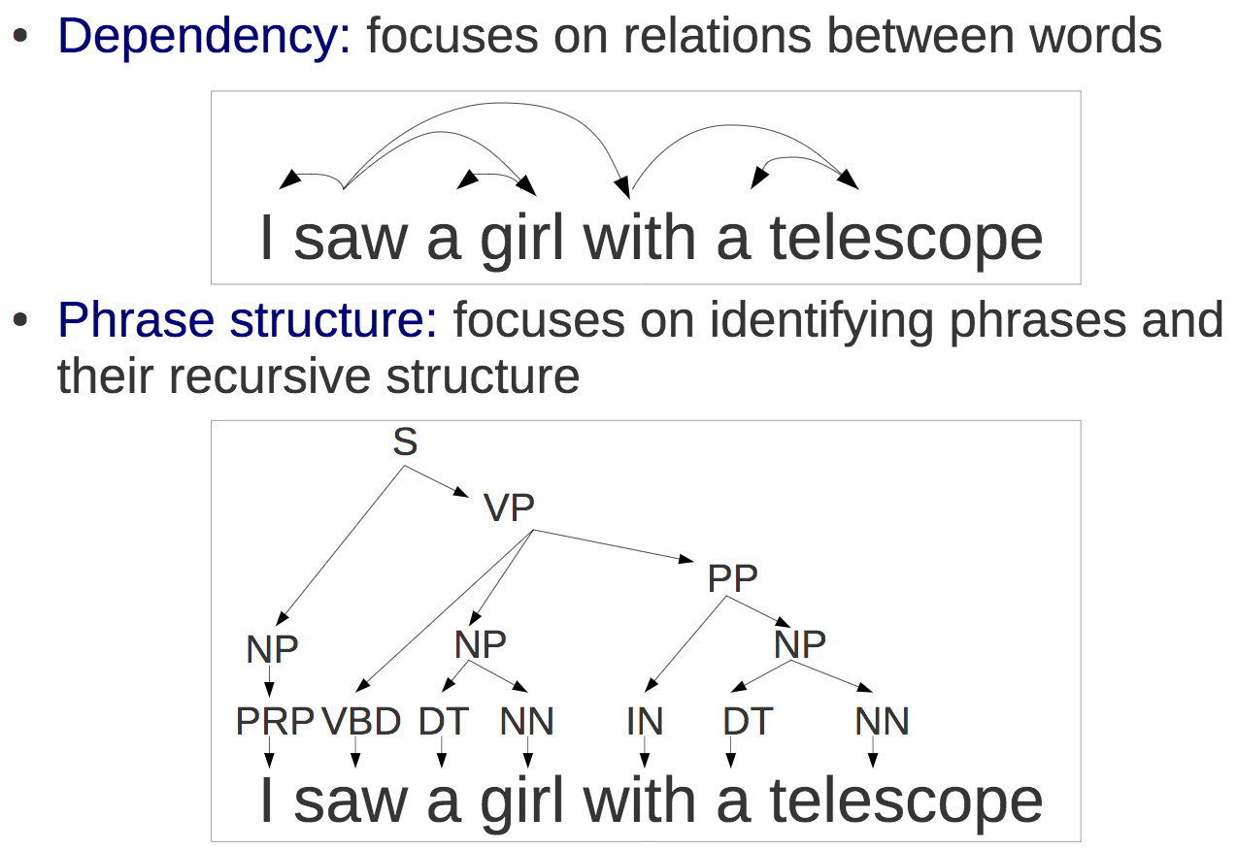
Parsing
Notes:
Dependency parsing is the task of extracting a dependency parse of a sentence that represents its grammatical structure and defines the relationships between “head” words and words, which modify those heads.

Slide 28
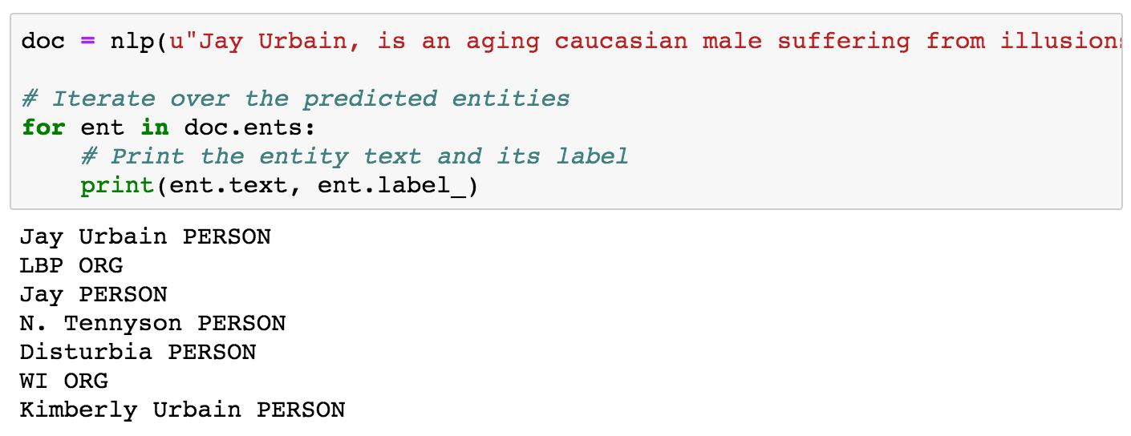
Named Entity Recognition
Identify real world object, for example, person, place, organization, etc.
Notes:
Machine learning methods:
Statistical machine learning model – Conditional Random Field
SOTA – Deep learning Transformer Model – “BERT”

Slide 29
Entity Negation - NegEx
Import to rule-in/rule-out medical concepts.
NegEx – rule-based algorithm, use with named entity model.
http://localhost:8888/notebooks/NLP_KG_2021/Scispacy_NE.ipynb
Notes:
Machine learning methods:
Statistical machine learning model – Conditional Random Field
SOTA – Deep learning Transformer Model – “BERT”

Slide 30
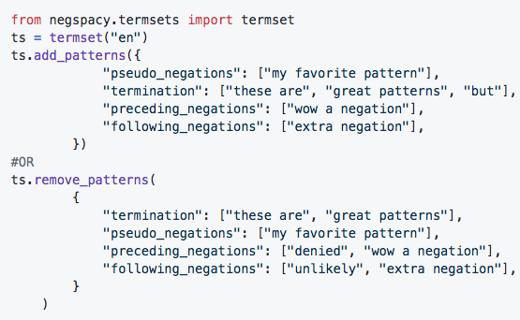
Entity Negation - NegEx
NegEx Patterns
psuedo_negations - phrases that are false triggers, ambiguous negations, or double negatives
preceding_negations - negation phrases that precede an entity
following_negations - negation phrases that follow an entity
termination - phrases that cut a sentence in parts, for purposes of negation detection (.e.g., "but")
Notes:
Machine learning methods:
Statistical machine learning model – Conditional Random Field
SOTA – Deep learning Transformer Model – “BERT”

Slide 31
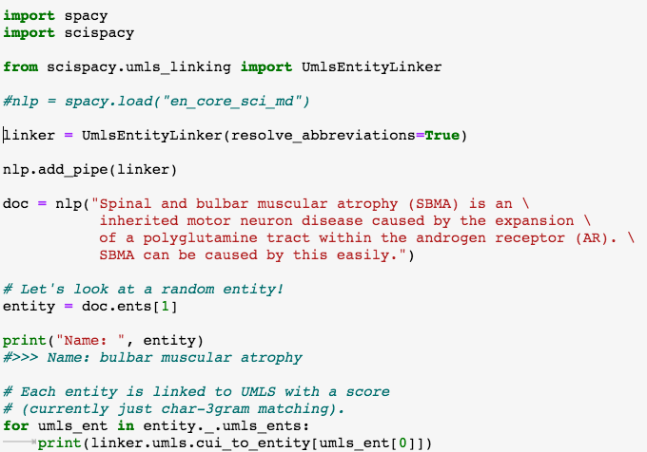
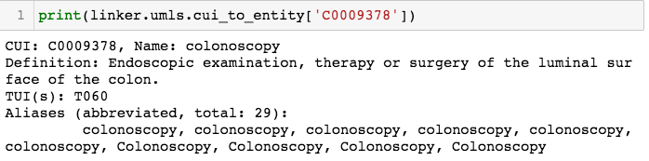
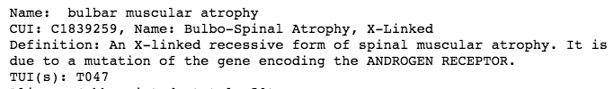
Entity Linking
Entity linking is used to ground named entities to a knowledge base with a unique id.
You can create your own knowledge base and rain a new entity linker
BIO:
http://34.136.131.39:8000/
Notes:
Machine learning methods:
Statistical machine learning model – Conditional Random Field
SOTA – Deep learning Transformer Model – “BERT”

Slide 32
NLP APPLICATIONS

Slide 33
NLP APPLICATIONS
Patient deidentification
Medical named entity recognition
Information extraction
Text classification, topic modeling, sentiment analysis
Named entity recognition
Machine translation
Stylistics
Speech recognition
Question answering, intelligent agents, dialog systems
Much more...

Slide 34
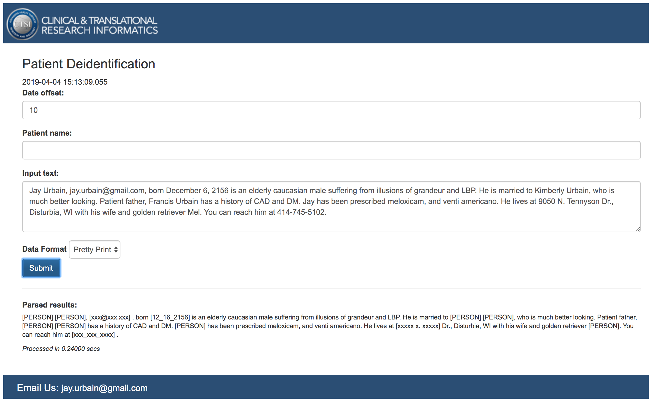
https://cis.ctsi.mcw.edu/deid/
Notes:
curl -H "Content-Type: application/json" -X POST -d '{"dateoffset":"10","name":"Mel","recordlist":["Jay Urbain, jay.urbain@gmail.com, born December 6, 2156 is an elderly caucasian male suffering from illusions of grandeur and LBP.", "He is married to Kimberly Urbain, who is much better looking.", "Patient father, Francis Urbain has a history of CAD and DM.", "Jay has been prescribed meloxicam, and venti americano.", "He lives at 9050 N. Tennyson Dr., Disturbia, WI with his wife and golden retriever Mel.", "You can reach him at 414-745-5102."]}' https://cis.ctsi.mcw.edu/deid/deidservice

Slide 35
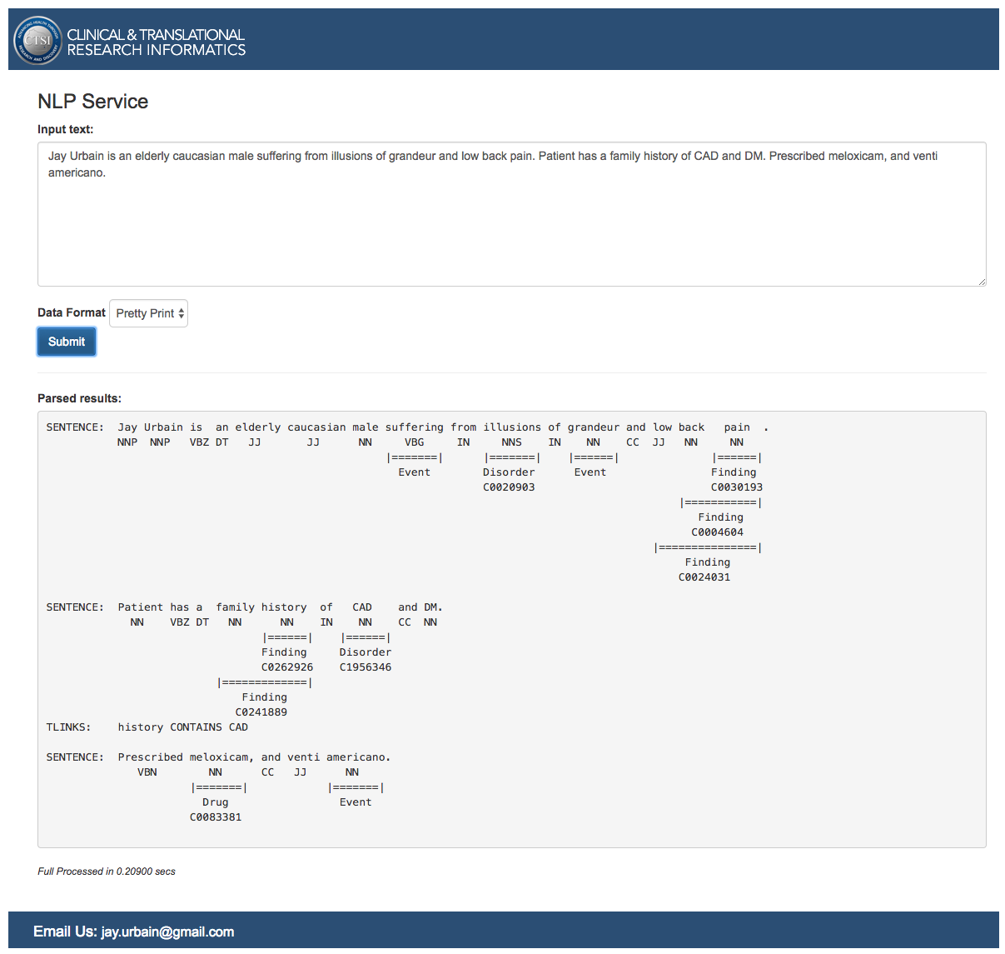
https://cis.ctsi.mcw.edu/nlp/
Clinical Named
Entity Identification
Notes:
curl -H "Content-Type: application/json" -X POST -d '{"recordlist":["Jay is elderly","Treated for illusions of grandeur","Family history of CAD"]}' https://cis.ctsi.mcw.edu/nlp/nlpservice

Slide 36
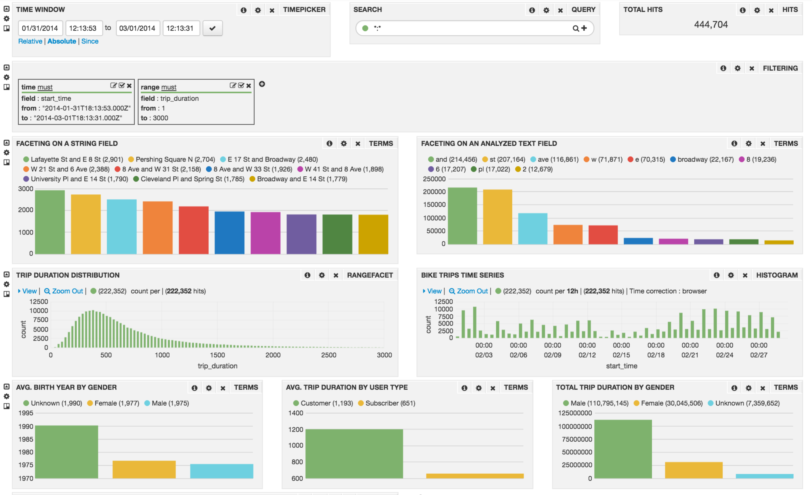
Search driven discovery: aggregating statistics from named entities

Slide 37
Information Extraction
Rule based: Regular expressions
Named entity recognition, dependency grammar
Combine NER + relation extraction in large model (BERT or similar)
Search (reverse search)
Question answering
Dependency parsing for relation

Slide 38
Prologue – Medical Record Machine “Translation” - work with Bradley Crotty, MD
COLONOSCOPY Procedure Note. Date of Procedure: [1_21_2016]. Primary Physician: [PERSON] [PERSON] [PERSON], MD. Attending Physician: [PERSON] [PERSON], MD. Fellow:None. Indications: Colon cancer screening for family history of colon cancer Colon cancer screening for family history of polyps.. Previous COLONOSCOPY: Yes. Date: [8_16_2007]. Medications Administered: Agents given by the anesthesia service during MAC. Procedure Details: The patient was placed in the left lateral position and monitored continuously with ECG tracing, pulse oximetry monitoring and direct observations. Medications were administered incrementally over the course of the procedure to achieve an adequate level of moderate sedation. After anorectal examination was performed, the Olympus CF H180 was inserted into the rectum and advanced under direct vision to the terminal ileum. The procedure was considered not difficult. During withdrawal examination, the final quality of the prep was good.. Bowel Prep Scale Right Colon: Grade 2 (minor amount of residual staining, small fragments of stool, and/or opaque liquid, but mucosa of colon segment is seen well) . Bowel Prep Scale for Transverse Colon: Grade 3 (entire mucosa of colon segment seen well, with no residual staining, small fragments of stool, or opaque liquid) . Bowel Prep Scale for Left Colon: Grade 2 (minor amount of residual staining, small fragments of stool, and/or opaque liquid, but mucosa of colon segment is seen well) Additional rinsing and suctioning (600 ml) were necessary to obtain adequate views. A careful inspection was made as the colonoscope was withdrawn, which did include a retroflexed evaluation of the rectum. Findings and interventions are described below. Appropriate photo documentation was obtained. Overall [PATIENT] L [PATIENT] did tolerate the procedure well, without undue discomfort, hypotension or desaturation. At the completion of the procedure she was transferred from the endoscopy suite to be recovered in the FSC observation area per protocol and was discharged when criteria was met. After adequate recovery from sedation, she was discharged to home, with appropriate plans for follow up in place. Scope in time: 0741 Cecum reached time: 0747. Scope out time: 0759. Findings:. Findings for the Anorectal: No mass. Findings for the Terminal Ileum: Normal ileal mucosa. Findings for the Cecum: Normal mucosa. Findings for the Ascending Colon: Normal mucosa. Findings for the Transverse Colon: 1 polyp 2 mm in size, sessile, removed by cold biopsy and sent for pathology. Findings for the Descending Colon: Normal mucosa. Findings for the Sigmoid Colon: Normal mucosa. Findings for the Rectum: 2 polyps 4 mm in size, sessile, removed by hot biopsy and sent for pathology Hypertrophied anal PAPillae Small anal fissure. Interventions: 1 polyp removed by cold biopsy 2 polyps removed by hot biopsy. Complications: None. Adverse Events: No. Impression: 1. Multiple, 3 colon polyps, removed by cold biopsy and hot biopsy and sent for pathology 2. Family history of colon cancer 3. Family history of polyps 4. Hypertrophied anal PAPillae 5. Anal fissure 6. Otherwise normal COLONOSCOPY to the terminal ileum. Recommendations: ? Avoid aspirin and NSAIDs for 14 days ? Await pathology results ?. Dietary recommendations: High fiber diet. ? Anusol HC or similar ointment for discomfort form anal fissure/PAPillitis ?. Repeat COLONOSCOPY in 5 years ? For the patient's next COLONOSCOPY, a 4 liter, split dose prep should be used. In addition, the patient should start a low residue diet two days before the exam and be on a clear liquid diet the day before the exam. ? Would use large caliber colonoscope ? Follow up with primary care physician. Histopathologic Diagnosis: A. Transverse colon polyp, polypectomy: ? Tubular adenoma. B. Rectal polyps, polypectomy: ? Tubular adenoma (x1). ? Hyperplastic polyp (x1).. Qualify for GI Quality project: Yes #@Screening@# Extent of Examination: #@Complete@# Pathology: #@Adenomatous change@# Appendiceal orifice Ileum Rectal polyp Rectal polyp Anal PAPillitis and small fissure @ 6 o'clock [PERSON] [PERSON] [PERSON], MD, FACP
Translation
Date of procedure:
1_21_2016
Indications for colon cancer screening:
Family history of polyps
Complications:
The procedure was considered not difficult
Findings for the transverse colon:
1 polyp 2mm
Tubular adenoma
Hyperplastic polyp
NSAIDS should be avoided:
14 days
Recommendations:
High fiber diet

Slide 39
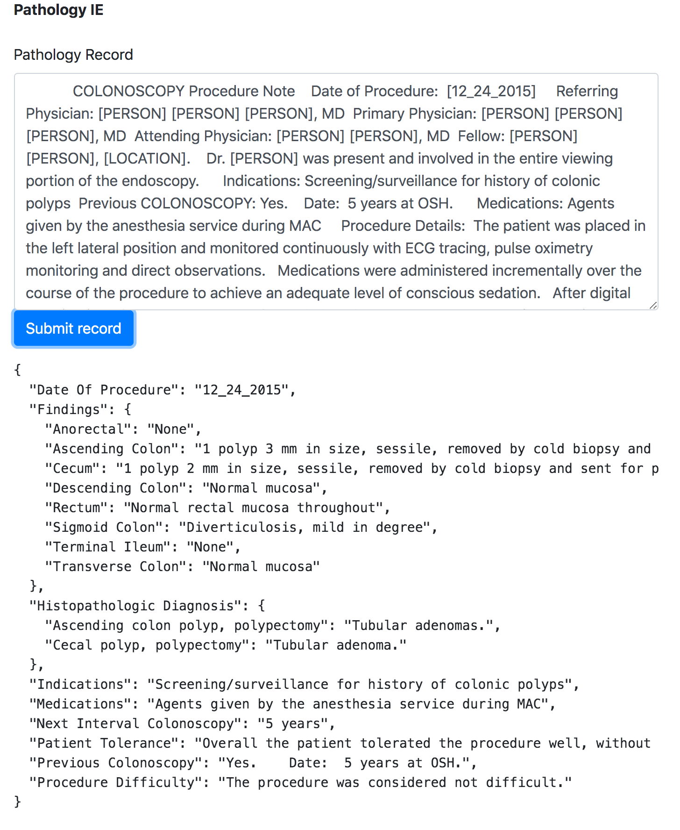
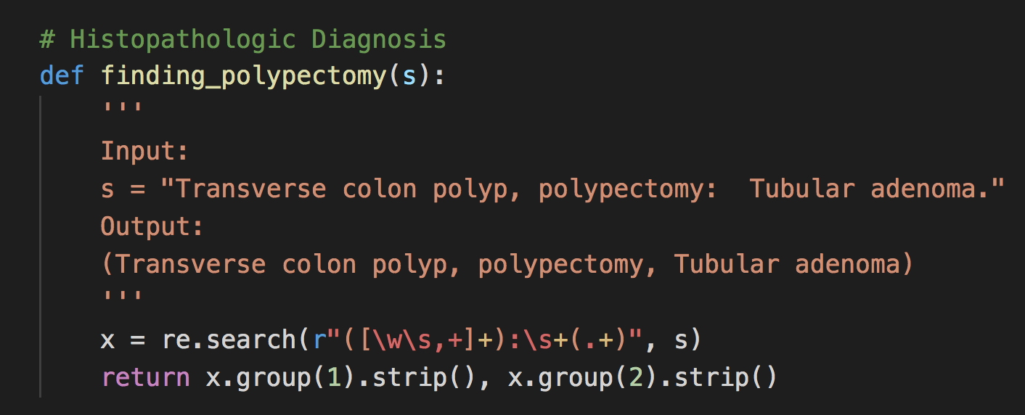
Information Extraction
Rule based - Regular expressions
High precision, low recall
Works well for semi-structured data
Poor generalizability
https://pathology-ie.appspot.com/
Notes:
curl -H 'Content-Type: application/json' -X POST -d '{"record":"COLONOSCOPY Procedure Note Date of Procedure: [12_30_2015] Referring Physician: [PERSON] [PERSON], MD Primary Physician: [PERSON] [PERSON], MD Attending Physician: [PERSON] [PERSON], MD Fellow: None Indications: Evaluate for any evidence of fistulous disease Previous COLONOSCOPY: No Medications Administered: Agents given by the anesthesia service during MAC Procedure Details: The patient was placed in the left lateral position and monitored continuously with ECG tracing, pulse oximetry monitoring and direct observations. Medications were administered incrementally over the course of the procedure to achieve an adequate level of conscious sedation. After anorectal examination was performed, the Olympus CF HQ190L was inserted into the rectum and advanced under direct vision to an impacted view of the terminal terminal ileum. The procedure was considered not difficult except for intubating the TI which was not completed despite multiple attempts in different positions. Overall [PATIENT] L [PATIENT] tolerated the procedure well, without undue discomfort, hypotension or desaturation. The patient was adequately recovered in the endoscopy suite and was discharged to home. During withdrawal examination, the final quality of the prep was [LOCATION] Bowel Prep Scale: Right Colon: Grade 1 (portion of mucosa of the colon segment seen, but other areas of the colon segment are not well seen because of staining, residual stool, and/or opaque liquid) Transverse Colon: Grade 1 (portion of mucosa of the colon segment seen, but other areas of the colon segment are not well seen because of staining, residual stool, and/or opaque liquid) Left Colon: Grade 1 (portion of mucosa of the colon segment seen, but other areas of the colon segment are not well seen because of staining, residual stool, and/or opaque liquid) A careful inspection was made as the colonoscope was withdrawn, including a retroflexed view of the rectum; findings and interventions are described below. Appropriate photo documentation was obtained. The patient tolerated the procedure well, and was recovered in the GI Lab observation area per protocol and was discharged when criteria was met. Scope insertion time: 0925 Cecum reached time: 0930 Scope withdrawal time: 1020 Findings: Anorectal: Normal Terminal Ileum: Only impacted view of terminal ileum obtained; despite multiple attempts unable to intubate the IC valve. What was seen of the terminal ileal mucosa appeared to be normal. The IC valve itself however appears to be narrowed and/or strictured Cecum: Normal mucosa except for 1 erosion on cecal fold above [LOCATION] valve without frank ulceration; biopsied separately Ascending Colon: Normal mucosa Transverse Colon: Normal mucosa Descending Colon: Normal mucosa Sigmoid Colon: Normal mucosa Rectum: Normal rectal mucosa throughout; linear erosions with shallow ulcerations on 3 folds in the rectum. Biopsies obtained. Findings are not typical of inflammatory bowel disease. Interventions: Biopsies obtained of the IC valve/distal TI, fold with erosion in cecum, random colon and rectal erosions/ulcers. Complications: None Impression: No fistula noted on this examination Very poor preparation Rectal and Cecal fold erosions shallow ulcerations as above Difficult to intubate IV valve; unclear whether this represents stricture, angulation or operator dependent Otherwise normal COLONOSCOPY to the terminal ileum Recommendations: Await pathology results Discussed with Dr. [PERSON] we will await biopsies and then decide on next steps after those are back and repeat CT scan is completed Should also better delineate NSAID history Histopathologic Diagnosis:pending Qualify for GI Quality project: No Kia Saeian, MD Addendum Pathology: A. TI, biopsy: ? Small bowel mucosa with no diagnostic abnormality. B. Cecal fold, biopsy: ? Colonic mucosa with focal mucosal erosion and regenerative changes; see note. Note: There is no definite morphologic evidence sugestive of inflammatory bowel ? disease. C. Random colon, biopsy: ? Colonic mucosa with no diagnostic abnormality. D. Rectum, biopsy: ? Colonic mucosa with focal nonspecific inflammation and regenerative changes."}' https://pathology-ie.appspot.com/api

Slide 40
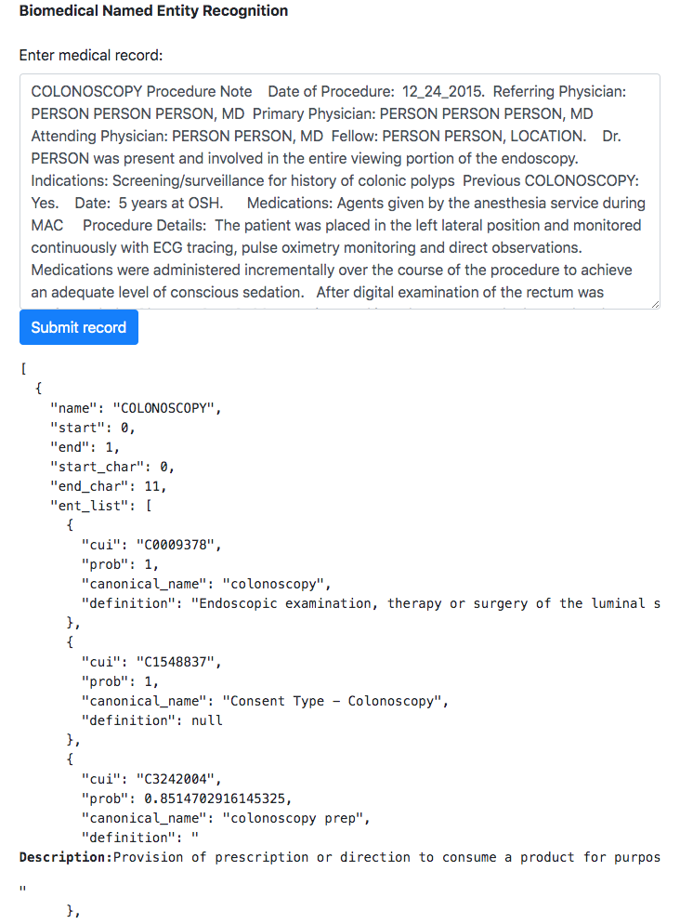
Information Extraction
Named Entity Model
Can use with dependency parse
Train machine learning model (sequence model)
Often can leverage pretrained model
Better recall and generalizability
Can suffer from lack of training data
http://35.194.6.2:8000/

Slide 41
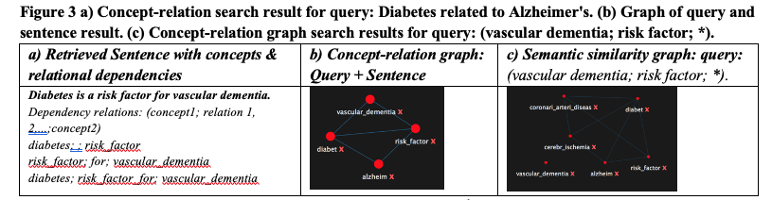
Information Extraction

Slide 42
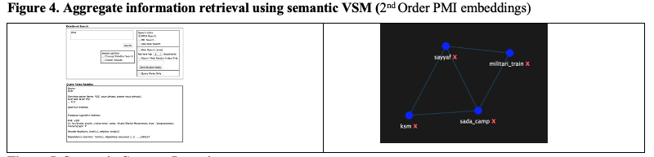
Information Extraction

Slide 43
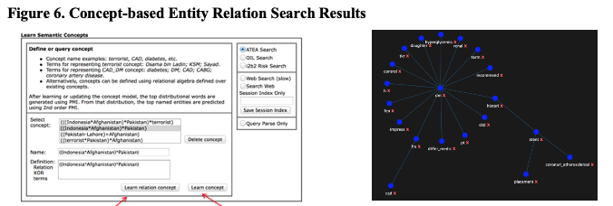
Information Extraction

Slide 44
Information Extraction
Named Entity Model
Update annotations
https://brat.nlplab.org/standoff.html

Slide 45
Information Extraction
Custom Named Entity Model
Leverage pretrained model
T1 C0040861_Triage 14 20 triage
T2 C0030193_Pain 47 51 pain
T3 C0184661_Interventional_procedure 133 143 procedures
T4 C0449210_OTH_tumor_staging_notation 162 167 other
T5 C1304888_Pain_control 168 180 pain control
T6 C0030193_Pain 168 172 pain
T7 C0013227_Pharmaceutical_Preparations 228 238 medication
T8 C0020746_Ice 254 257 ice
T9 C0556030_Repositioning_procedure 262 275 repositioning
T10 C0537670_Oprelvekin 293 301 Informed
T11 C1299581_Able_finding 429 433 able
T12 C0310367_Today 449 454 today
T13 C0004448_Awareness 469 474 aware
T14 C0310367_Today 528 533 today
Patient LM on triage line reporting unbearable pain, requesting call back. This writer placed callback to patient, reviewed recent procedures, current meds and other pain control options with patient. Patient reports taking medication as prescribed, ice and repositioning not effective. Informed patient I would speak with provider to discuss options and call him back. Spoke with APNP MA, update given. MA able to see patient today. Scheduling aware and contacted patient. Patient scheduled for 11:40 today.

Slide 46
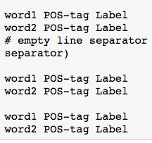
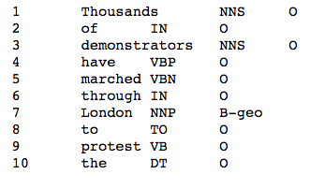
Information Extraction
Named Entity Model
Train new model

Slide 47
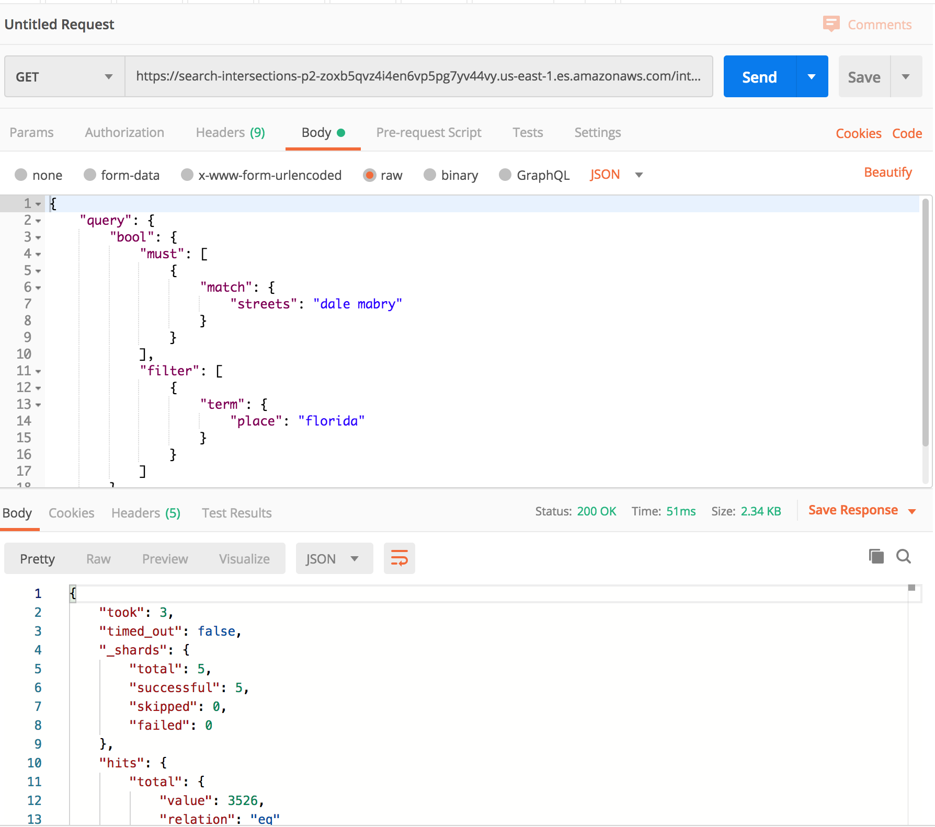
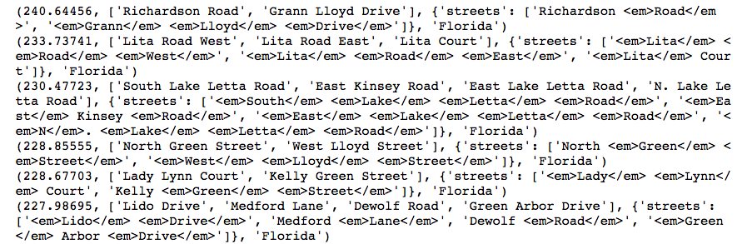
Information Extraction
Search (inverse)
Index as entities of interest
Query as document

Slide 48
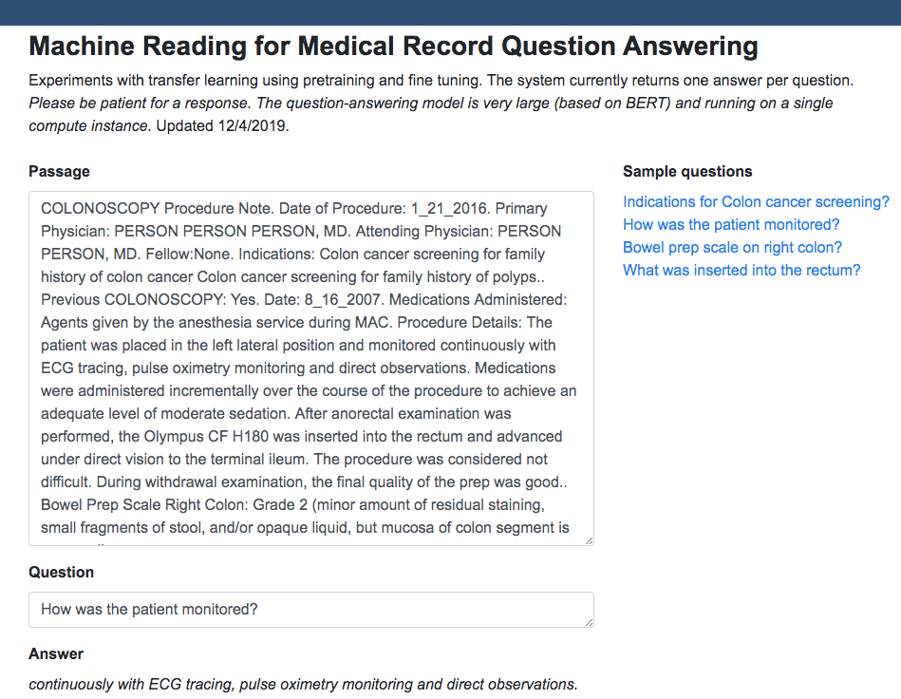
Question Answering
http://35.239.172.96:8080/

Slide 49
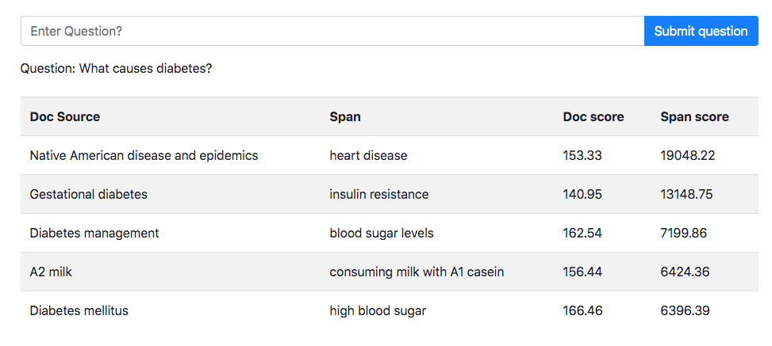
Open Domain Question Answering

Slide 50
Topic Models: Passage-Concept TREC Collection
Concept 1: Blood protein | Concept 2: Lupus Erythematosus | Concept 8: Lysosome | Topic 57: Signaling pathway
antibodi (0.4895) cell (0.2565) serum (0.2158) anti (0.2042) plasma (0.1544) protein (0.1498) membran (0.0869) incub (0.0718) human (0.0713) monoclon (0.0677) express (0.0623) bind (0.0596) concentr (0.0541) beta (0.0513) IG (0.0507) alpha (0.0477) mous (0.0477) rabbit (0.0459) CD (0.0434) glycoprotein (0.0423) | lupu (0.6477) SLE (0.4645) system (0.3527) patient (0.3482) erythematosu (0.3394) diseas (0.1749) antibodi (0.1172) cell(0.1109) anti (0.0779) nephriti (0.0744) mice (0.0618) autoantibodi(0.0599) clinic (0.0579) autoimmun (0.0557) DNA (0.0545) human (0.0479) syndrom (0.0429) factor (0.0428) ISI ( 0.0424) IG ( 0.0382) | lysosom (0.9999) cell (0.2326) protein (0.1848) membran (0.1514) endosom (0.1297) enzym (0.1019) degrad (0.0912) transport (0.0778) acid (0.0704) compart (0.0644) storag (0.0597) target (0.0582) pathwai (0.0540) accumul (0.0536) diseas (0.0528) human (0.0522) express (0.0474) cathepsin (0.0456) organel (0.0414) golgi (0.0402) | signal (0.7022) pathwai (0.4053) cell (0.2482) protein (0.1805) regul (0.1107) express (0.0970) kinase (0.0896) receptor (0.0861) mediat (0.0842) gene (0.0788) factor (0.0737) transduct (0.0650) beta (0.0597) respons (0.0557) bind (0.0515) inhibit (0.0502) transcript(0.0478) interact (0.0390) NF (0.0381) SRP (0.0380)
Notes:
Latent Dirichlet Bayesian topic model. Written from scratch

Slide 51
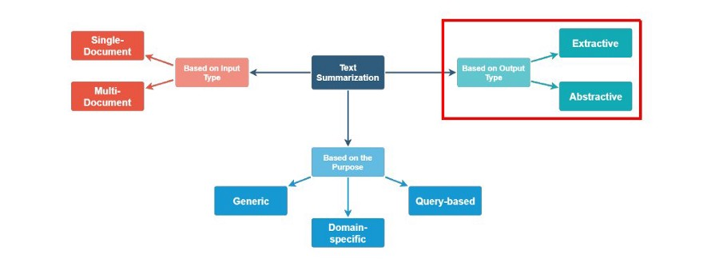
Text Summarization
Extractive text summarization
Extract representative sentences from document(s). Classification task.
Abstractive text summarization
Generate summary. May include words not in the original document. compressed paraphrasing of the main contents of the document
Fine-tune BERT for Extractive Summarization, “BertSum”, Liu, 2019.
Text Summarization with Pretrained Encoders, Liu, Lapata, 2019.
Notes:
Challenge: understanding of document to produce representative summaries.
Fine-tune BERT for Extractive SummarizationYang LiuInstitute for Language, Cognition and ComputationSchool of Informatics, University of Edinburgh10 Crichton Street, Edinburgh EH8 9AByang.liu2@ed.ac.ukAbstractBERT (Devlin et al., 2018), a pre-trainedTransformer (Vaswani et al., 2017) model,has achieved ground-breaking performance onmultiple NLP tasks. In this paper, we describeBERTSUM, a simple variant of BERT, for ex-tractive summarization. Our system is the stateof the art on the CNN/Dailymail dataset, out-performing the previous best-performed sys-tem by 1.65 on ROUGE-L. The codes to repro-duce our results are available at https://github.com/nlpyang/BertSum
Text Summarization with Pretrained Encoders
Yang Liu, Mirella Lapata
Bidirectional Encoder Representations from Transformers (BERT) represents the latest incarnation of pretrained language models which have recently advanced a wide range of natural language processing tasks. In this paper, we showcase how BERT can be usefully applied in text summarization and propose a general framework for both extractive and abstractive models. We introduce a novel document-level encoder based on BERT which is able to express the semantics of a document and obtain representations for its sentences. Our extractive model is built on top of this encoder by stacking several inter-sentence Transformer layers. For abstractive summarization, we propose a new fine-tuning schedule which adopts different optimizers for the encoder and the decoder as a means of alleviating the mismatch between the two (the former is pretrained while the latter is not). We also demonstrate that a two-staged fine-tuning approach can further boost the quality of the generated summaries. Experiments on three datasets show that our model achieves state-of-the-art results across the board in both extractive and abstractive settings. Our code is available at this https URL
https://arxiv.org/pdf/1908.08345.pdf

Slide 52
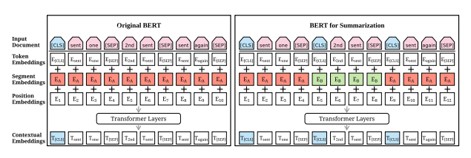
Text Summarization - BertSUM
Selects the most important sentences from a document(s).
Insert [CLS] tokens at the start of each sentence.
Each [CLS] symbol collects features for the sentence preceding it.
Use interval segment embedding (E_{A}, E_{B}) to distinguish multiple sentences.
Fine-tune BERT for Extractive Summarization, “BertSum”, Liu, 2019.
Notes:
Challenge: understanding of document to produce representative summaries.
Fine-tune BERT for Extractive Summarization, Yang Liu, Institute for Language, Cognition and Computation School of Informatics, University of Edinburgh10 Crichton Street, Edinburgh EH8 9AByang.liu2@ed.ac.ukAbstractBERT (Devlin et al., 2018), a pre-trained Transformer (Vaswani et al., 2017) model has achieved ground-breaking performance on multiple NLP tasks. In this paper, we describe BERTSUM, a simple variant of BERT, for ex-tractive summarization. Our system is the state of the art on the CNN/Daily mail dataset, out-performing the previous best-performed system by 1.65 on ROUGE-L. The codes to repro-duce our results are available at https://github.com/nlpyang/BertSum
Text Summarization with Pretrained Encoders
Yang Liu, Mirella Lapata
Bidirectional Encoder Representations from Transformers (BERT) represents the latest incarnation of pretrained language models which have recently advanced a wide range of natural language processing tasks. In this paper, we showcase how BERT can be usefully applied in text summarization and propose a general framework for both extractive and abstractive models. We introduce a novel document-level encoder based on BERT which is able to express the semantics of a document and obtain representations for its sentences. Our extractive model is built on top of this encoder by stacking several inter-sentence Transformer layers. For abstractive summarization, we propose a new fine-tuning schedule which adopts different optimizers for the encoder and the decoder as a means of alleviating the mismatch between the two (the former is pretrained while the latter is not). We also demonstrate that a two-staged fine-tuning approach can further boost the quality of the generated summaries. Experiments on three datasets show that our model achieves state-of-the-art results across the board in both extractive and abstractive settings. Our code is available at this https URL
https://arxiv.org/pdf/1908.08345.pdf

Slide 53
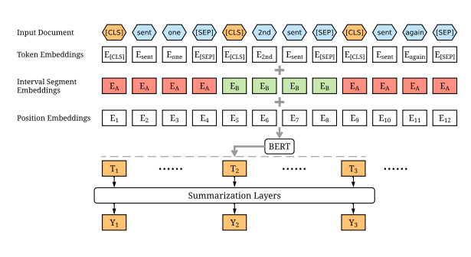
Text Summarization - BertSUM
Outputs a list of scores showing how well each sentence represents the documents. [sent1, sent2, sent3, sent4, sent5] has scores [score1, score2, score3, score4, score5].
The output is then feed into Summarization Layers for summarization.
Fine-tune BERT for Extractive Summarization, “BertSum”, Liu, 2019.
Notes:
Challenge: understanding of document to produce representative summaries.
Fine-tune BERT for Extractive SummarizationYang LiuInstitute for Language, Cognition and ComputationSchool of Informatics, University of Edinburgh10 Crichton Street, Edinburgh EH8 9AByang.liu2@ed.ac.ukAbstractBERT (Devlin et al., 2018), a pre-trainedTransformer (Vaswani et al., 2017) model,has achieved ground-breaking performance onmultiple NLP tasks. In this paper, we describeBERTSUM, a simple variant of BERT, for ex-tractive summarization. Our system is the stateof the art on the CNN/Dailymail dataset, out-performing the previous best-performed sys-tem by 1.65 on ROUGE-L. The codes to repro-duce our results are available at https://github.com/nlpyang/BertSum
Text Summarization with Pretrained Encoders
Yang Liu, Mirella Lapata
Bidirectional Encoder Representations from Transformers (BERT) represents the latest incarnation of pretrained language models which have recently advanced a wide range of natural language processing tasks. In this paper, we showcase how BERT can be usefully applied in text summarization and propose a general framework for both extractive and abstractive models. We introduce a novel document-level encoder based on BERT which is able to express the semantics of a document and obtain representations for its sentences. Our extractive model is built on top of this encoder by stacking several inter-sentence Transformer layers. For abstractive summarization, we propose a new fine-tuning schedule which adopts different optimizers for the encoder and the decoder as a means of alleviating the mismatch between the two (the former is pretrained while the latter is not). We also demonstrate that a two-staged fine-tuning approach can further boost the quality of the generated summaries. Experiments on three datasets show that our model achieves state-of-the-art results across the board in both extractive and abstractive settings. Our code is available at this https URL
https://arxiv.org/pdf/1908.08345.pdf

Slide 54
Text Summarization
text_body = '''
The Chrysler Building, the famous art deco New York skyscraper, will be sold for a small fraction of its previous sales price.
The deal, first reported by The Real Deal, was for $150 million, according to a source familiar with the deal.
Mubadala, an Abu Dhabi investment fund, purchased 90% of the building for $800 million in 2008.
Real estate firm Tishman Speyer had owned the other 10%.
The buyer is RFR Holding, a New York real estate company.
Officials with Tishman and RFR did not immediately respond to a request for comments.
It's unclear when the deal will close.
The building sold fairly quickly after being publicly placed on the market only two months ago.
The sale was handled by CBRE Group.
The incentive to sell the building at such a huge loss was due to the soaring rent the owners pay to Cooper Union, a New York college, for the land under the building.
The rent is rising from $7.75 million last year to $32.5 million this year to $41 million in 2028.
Meantime, rents in the building itself are not rising nearly that fast.
While the building is an iconic landmark in the New York skyline, it is competing against newer office towers with large floor-to-ceiling windows and all the modern amenities.
Still the building is among the best known in the city, even to people who have never been to New York.
It is famous for its triangle-shaped, vaulted windows worked into the stylized crown, along with its distinctive eagle gargoyles near the top.
It has been featured prominently in many films, including Men in Black 3, Spider-Man, Armageddon, Two Weeks Notice and Independence Day.
The previous sale took place just before the 2008 financial meltdown led to a plunge in real estate prices.
Still there have been a number of high profile skyscrapers purchased for top dollar in recent years, including the Waldorf Astoria hotel, which Chinese firm Anbang Insurance purchased in 2016 for nearly $2 billion, and the Willis Tower in Chicago, which was formerly known as Sears Tower, once the world's tallest.
Blackstone Group (BX) bought it for $1.3 billion 2015.
The Chrysler Building was the headquarters of the American automaker until 1953, but it was named for and owned by Chrysler chief Walter Chrysler, not the company itself.
Walter Chrysler had set out to build the tallest building in the world, a competition at that time with another Manhattan skyscraper under construction at 40 Wall Street at the south end of Manhattan. He kept secret the plans for the spire that would grace the top of the building, building it inside the structure and out of view of the public until 40 Wall Street was complete.
Once the competitor could rise no higher, the spire of the Chrysler building was raised into view, giving it the title.
'''

Slide 55
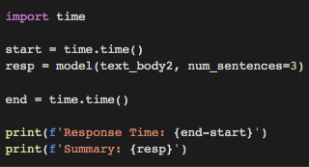
Text Summarization
Response Time: 0.29914021492004395 Summary: The Chrysler Building, the famous art deco New York skyscraper, will be sold for a small fraction of its previous sales price. Mubadala, an Abu Dhabi investment fund, purchased 90% of the building for $800 million in 2008. The buyer is RFR Holding, a New York real estate company. It has been featured prominently in many films, including Men in Black 3, Spider-Man, Armageddon, Two Weeks Notice and Independence Day.

Slide 56
Text Summarization
text_body2 = '''
COLONOSCOPY Procedure Note Date of Procedure: [12_24_2015] Referring Physician: [PERSON] [PERSON] [PERSON], MD Primary Physician: [PERSON] [PERSON] [PERSON],
MD Attending Physician: [PERSON] [PERSON], MD Fellow: [PERSON] [PERSON], [LOCATION]. Dr. [PERSON] was present and involved in the entire viewing portion of the endoscopy.
Indications: Screening/surveillance for history of colonic polyps Previous COLONOSCOPY: Yes. Date: 5 years at OSH.
Medications: Agents given by the anesthesia service during MAC Procedure Details: The patient was placed in the left lateral position and monitored continuously
with ECG tracing, pulse oximetry monitoring and direct observations. Medications were administered incrementally over the course of the procedure to achieve an
adequate level of conscious sedation. After digital examination of the rectum was performed, the Olympus CF HQ190L was inserted into the rectum and advanced
under direct vision to the cecum, which was identified by the ileocecal valve and appendiceal orifice. The procedure was considered not difficult. Overall
the patient tolerated the procedure well, without undue discomfort, hypotension or desaturation. The patient was adequately recovered in the endoscopy suite
and was discharged to home. During withdrawal examination, the final quality of the prep was [LOCATION] Bowel Prep Scale: Right Colon: Grade 2
(minor amount of residual staining, small fragments of stool, and/or opaque liquid, but mucosa of colon segment is seen well) Transverse Colon: Grade 2
(minor amount of residual staining, small fragments of stool, and/or opaque liquid, but mucosa of colon segment is seen well) Left Colon: Grade 2
(minor amount of residual staining, small fragments of stool, and/or opaque liquid, but mucosa of colon segment is seen well) Additional rinsing and
suctioning were necessary to obtain adequate views. A careful inspection was made as the colonoscope was withdrawn. This did include a retroflexed
evaluation of the rectum. Findings and interventions are described below. Appropriate photo documentation was obtained. Overall [PATIENT] F [PATIENT]
did tolerate the procedure well, without undue discomfort, hypotension, or desaturation. At the completion of the procedure he was transferred from the
endoscopy suite to be recovered in the GI Lab observation area per protocol and was discharged when criteria was met. After adequate recovery from sedation,
he was discharged to home, with appropriate plans for follow up in place. Scope in time: 1131 Cecum reached time: 1143 Scope out time: 1157
Findings: Anorectal: Normal Cecum: 1 polyp 2 mm in size, sessile, removed by cold biopsy and sent for pathology Ascending Colon: 1 polyp 3 mm in size,
sessile, removed by cold biopsy and sent for pathology Transverse Colon: Normal mucosa Descending Colon: Normal mucosa Sigmoid Colon:
Diverticulosis, mild in degree Rectum: Normal rectal mucosa throughout Interventions: 2 polyps removed by cold biopsy Complications: None
Adverse Events: No Impression: 1. Multiple, 2 colon polyps, removed by cold biopsy and sent for pathology 2. Mild diverticulosis of left side 3.
Otherwise, normal COLONOSCOPY to cecum Recommendations: Repeat COLONOSCOPY in 5 years Next Interval COLONOSCOPY: 5 years Histopathologic Diagnosis: A. Cecal polyp, polypectomy: ?
Tubular adenoma. B. Ascending colon polyp, polypectomy: ? Tubular adenomas. Qualify for GI Quality project: Yes #@Surveillance@# Extent of Examination: #@Complete@#
Pathology: #@Adenomatous change@# Gokulakrishnan Balasubramanian, MD GI Faculty Note I was present for the entire viewing portion of the endoscopy and performed the
entire procedure with Dr. [PERSON]. [PERSON] [PERSON] [PERSON], MD Assistant Professor, Division of Gastroenterology Medical College of Wisconsin
'''

Slide 57
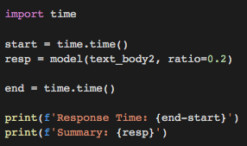
Text Summarization
Response Time: 0.26926517486572266 Summary: COLONOSCOPY Procedure Note Date of Procedure: [12_24_2015] Referring Physician: [PERSON] [PERSON] [PERSON], MD Primary Physician: [PERSON] [PERSON] [PERSON], MD Attending Physician: [PERSON] [PERSON], MD Fellow: [PERSON] [PERSON], [LOCATION]. Dr. [PERSON] was present and involved in the entire viewing portion of the endoscopy. Medications: Agents given by the anesthesia service during MAC Procedure Details: The patient was placed in the left lateral position and monitored continuously with ECG tracing, pulse oximetry monitoring and direct observations. A careful inspection was made as the colonoscope was withdrawn. Otherwise, normal COLONOSCOPY to cecum Recommendations: Repeat COLONOSCOPY in 5 years Next Interval COLONOSCOPY: 5 years Histopathologic Diagnosis: A. Cecal polyp, polypectomy: ? Qualify for GI Quality project: Yes #@Surveillance@# Extent of Examination: #@Complete@# Pathology: #@Adenomatous change@# Gokulakrishnan Balasubramanian, MD GI Faculty Note I was present for the entire viewing portion of the endoscopy and performed the entire procedure with Dr. [PERSON]. [PERSON] [PERSON] [PERSON], MD Assistant Professor, Division of Gastroenterology Medical College of Wisconsin

Slide 58
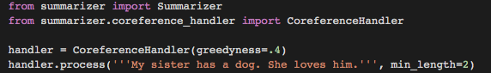
Text Summarization – co-reference resolution
['My sister has a dog.', 'My sister loves a dog.']

Slide 59
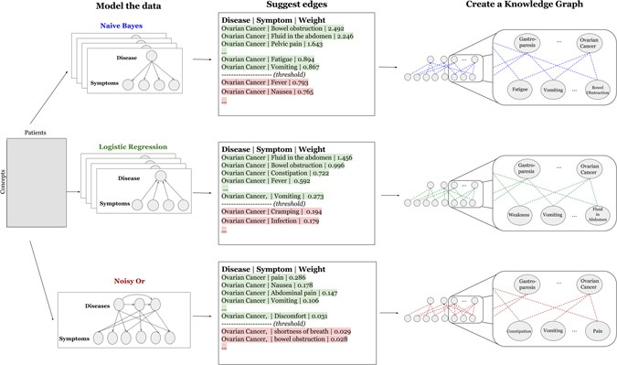
Healthcare Knowledge Graph Linking Disease, Symptom, & Health Risk Factors
Rotmensch, M., Halpern, Y., Tlimat, A. et al. Learning a Health Knowledge Graph from Electronic Medical Records. Sci Rep 7, 5994 (2017). https://doi.org/10.1038/s41598-017-05778-z
Notes:
Very interesting deep graph neural network libraries being developed.

Slide 60
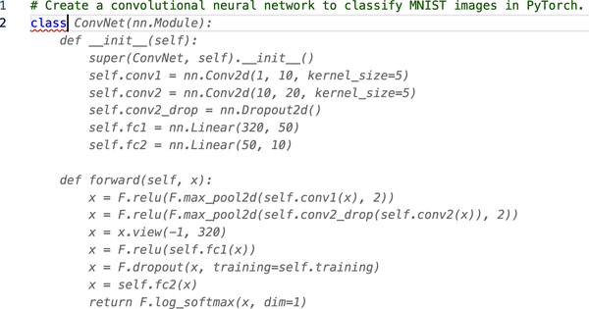
Code generation with GPT
Transformers power applications like GitHub’s Copilot, which can convert a comment into source code

Slide 61


Language Generation with GPT3
Language Models are Few-Shot Learners
https://arxiv.org/pdf/2005.14165
https://huggingface.co/blog/few-shot-learning-gpt-neo-and-inference-api
Notes:
Very interesting deep graph neural network libraries being developed.
After training, the learned similarity function can be used for making predictions for unseen queries. We can use the similarity function to compare the query with every sample in the support set and calculate the similarity scores. Then, find the sample with the highest similarity score and use it as the prediction.

Slide 62

Code Generation with GPT3
Language Models are Few-Shot Learners
https://arxiv.org/pdf/2005.14165
Do demo at:
http://localhost:8888/notebooks/gpt-3-notebook.ipynb#
Notes:
Very interesting deep graph neural network libraries being developed.

Slide 63

CLIP: Learning Transferable Visual Models From Natural Language Supervision
Learns visual concepts from natural language supervision.
CLIP pre-trains an image encoder and a text encoder to predict which images were paired with which texts in a dataset.
The trained encoders are then used to turn CLIP into a zero-shot classifier.
All of a dataset’s classes are turned into captions such as “a photo of a dog” and predict the class of the caption CLIP estimates best pairs with a given image.
https://openai.com/blog/clip/

Slide 64

CLIP: Connecting Text and Images
https://arxiv.org/abs/2103.00020

Slide 65

Image Generation with CLIP and VQ-GAN
https://openai.com/blog/clip/
https://arxiv.org/abs/2112.10741
https://github.com/openai/glide-text2im

Slide 66

Image Generation with CLIP and Diffusion Guided Networks
https://arxiv.org/abs/2112.10741
https://github.com/openai/glide-text2im

Slide 67
REPRESENTING TEXT

Slide 68
ONE-HOT ENCODING
Words are categorical, they have no ordinal relationship. So, they can’t just be numerically encoded.
For each word:
Numerically encode each word: {red:0, green:1, blue:2}
Generate vector of zeros the length of all possible words/categories
Set the index value for the word in the vector
red, green, blue
1, 0, 0
0, 1, 0
0, 0, 1

Slide 69

WORD EMBEDDINGS
One-hot results in sparse vector representation (mostly zeros, hi dimensions).
Word embeddings provide dense vector representations.
Idea is to “embed” words into a lower-dimensionality space.
The dimensions of this space are typically defined by word context, i.e., semantically similar words are embedded near each other.
Popular algorithms:
Point-wise mutual information (PMI)
Word2Vec: Skip-gram or CBOW
GLoVE

Slide 70


Slide 71

Embeddings: Projects into a word embedding space
https://www.tensorflow.org/tutorials/representation/word2vec

Slide 72


Slide 73
NETWORK ARCHITECTURE – RNNS / LSTMS

Slide 74

RECURRENT LAYERS
RNNs share the weights between the time steps
Condition the neural network on all previous words
(and all document in the end)
RAM requirement only scales with number of timesteps

Slide 75
STATE OF THE ART

Slide 76



NLP: With deep Learning, reality is getting closer to vision
Alexa, re-order Thai Peanut Sauce
Ok Google, what’s my commute?
Siri, play Stompy the Bear
Notes:
Now if you’re in AI, you’ve probably been excited about AI since you were about … eight years old. I know I have.
For years, we’ve all been dreaming about having computers that can talk to us.
The ability to use language is an essential ingredient of the AI vision,
and the quest to endow computers with this ability has been the ultimate driver of NLP research for more than 50 years.
This dream is ultimately the reason why I’m standing here today. [>]

Slide 77

Encoder-Decoder Architecture Sequence-to-Sequence Model - Neural Machine Translation
Encoder RNN encodes input sequence into a fixed size vector, and then is passed repeatedly to decoder RNN.

Slide 78


Neural Machine Translation (encoding)
source language (English)
source language (English)
target language (French)
target language (French)

Slide 79

Attention
Attention mechanism allows the network to refer back to the input sequence, instead of forcing it to encode all information into one fixed length vector.

Slide 80

Self-Attention
"The animal didn't cross the street because it was too tired"

Slide 81


Transformer

Slide 82


Slide 83


Slide 84
Links
Here is a list of Github repositories of recent courses I’ve developed:
https://github.com/jayurbain/DataScienceIntro
https://github.com/jayurbain/machine-learning
https://github.com/jayurbain/artificial-intelligence
Data Driven Wisconsin Workshop:
https://github.com/jayurbain/DeepNLPIntro2019
https://www.datadrivenwi.org/ .

